Slide 1
Hypothesis Testing using Statistical Tests

Slide 2
Learning Objectives
By the end of this session, you will be able to:
Understand when to use which statistical tests
Apply and practice the various steps of Hypothesis Testing
Understand the process of one sample and two sample tests.
Draw inferences and conclusion.
Understand the concept of degrees of freedom

Slide 3
What is a Hypothesis and Hypothesis Testing?
An assumption or educated guess about a population parameter.
Tested using sample data.
Hypothesis testing is like a detective game where you :
1. start with an assumption (a hypothesis);
2. then collect evidence (data) to decide whether
3. your assumption is likely to be true or not.
It’s a way of making decisions or inferences about a population based on a sample of data.

Slide 4
Steps in Hypothesis Testing (Recap)
1. Formulate H₀ and H₁
1
2. Choose α
2
3. Select Test
3
4. Calculate Test Statistic
4
5. Make Decision
5

Slide 5
Reference
Test statistics$= \frac{Sample statistic−Population Parameter}{Standard Error}$
Commonly used Critical z values
Significance Level (⍺) | Two-Tailed Test | One-Tailed Test (Left) | One-Tailed Test (Right)
0.01 | ±2.58 | -2.326 | +2.326
0.05 | ±1.96 | -1.645 | +1.645
0.10 | ±1.645 | -1.282 | +1.282

Slide 6
Statistical Test Computations

Slide 7
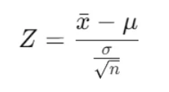
Testing of Mean – One sample
Testing of Mean – One sample – Large Sample(>=30) and Population SD is known
Test used: Z test (as the sample size is large and population SD is known)
Test statistic:

Slide 8
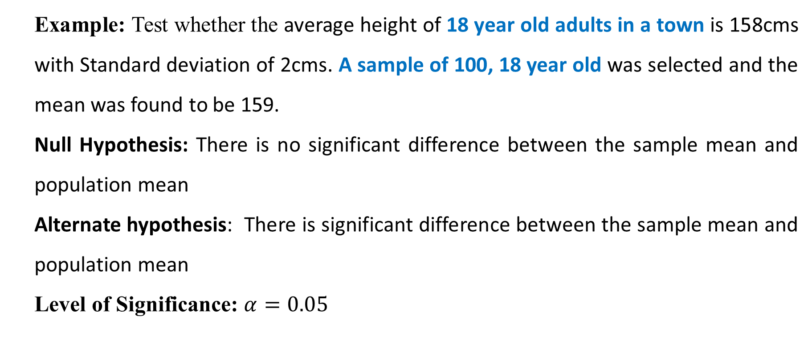
Testing of Mean – One sample
Testing of Mean – One sample – Large Sample(>=30) and Population SD is known
Example: Test whether the average height of 18 year old adults in a town is 158cms with Standard deviation of 2cms. A sample of 100, 18 year old was selected and the mean was found to be 159.
Null Hypothesis: There is no significant difference between the sample mean and population mean
Alternate hypothesis: There is significant difference between the sample mean and population mean
Level of Significance: $α=0.05$

Slide 9
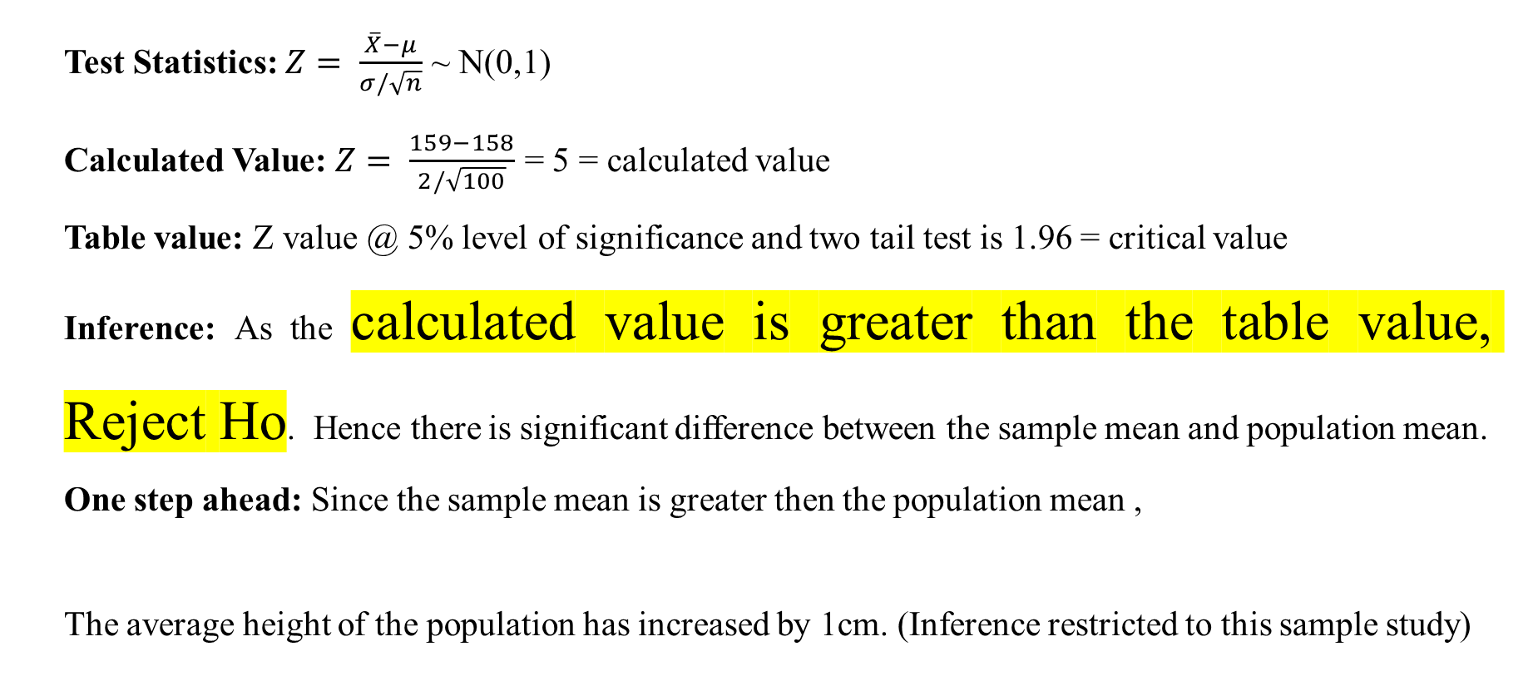
Calculation and Result
Test Statistics: $Z= \frac{\overline{X}−μ}{σ/\sqrt{n}}$ ~ N(0,1)
Calculated Value: $Z= \frac{159−158}{2/\sqrt{100}}$ = 5 = calculated value
Table value: Z value @ 5% level of significance and two tail test is 1.96 = critical value
Inference: As the calculated value is greater than the table value, Reject Ho. Hence there is significant difference between the sample mean and population mean.
One step ahead: Since the sample mean is greater then the population mean ,
The average height of the population has increased by 1cm. (Inference restricted to this sample study)

Slide 10
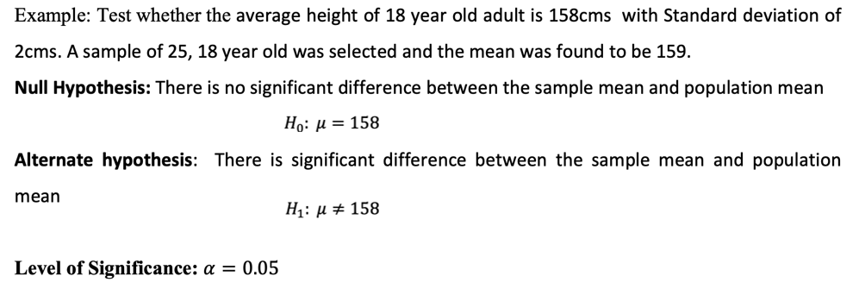
Testing of Mean – One sample
Testing of Mean – One sample – Small Sample(<30) and Population SD is known

Slide 11
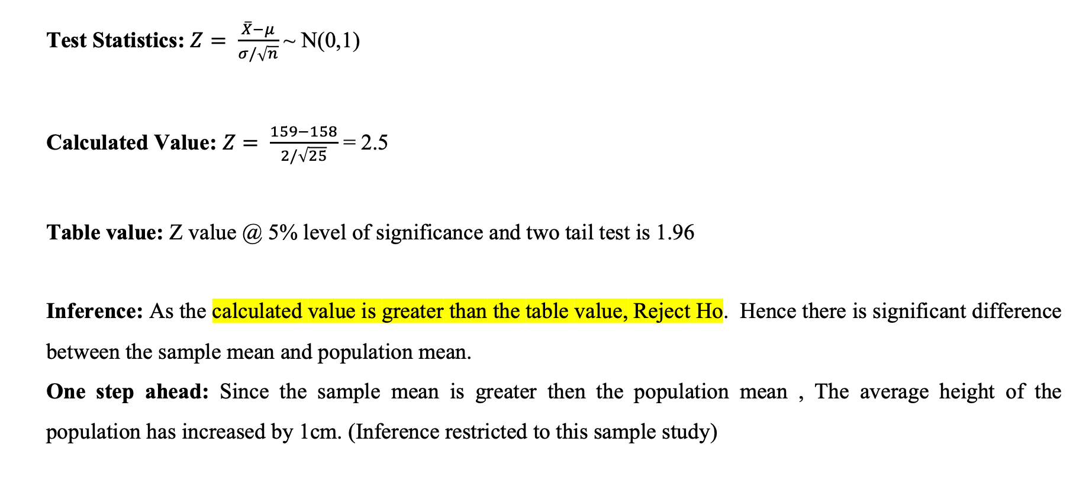

Slide 12
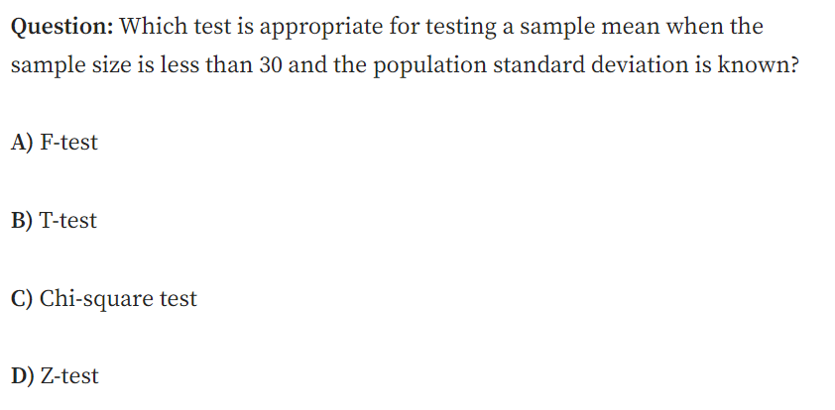
MCQ

Slide 13
MCQ
MCQ
Answer: D) Z-test
Explanation: Even though the sample size is small, if the population standard deviation (SD) is known and the data is approximately normally distributed, a Z-test can still be used. However, if the sample size is small and the population SD is unknown, a T-test would be more appropriate.

Slide 14
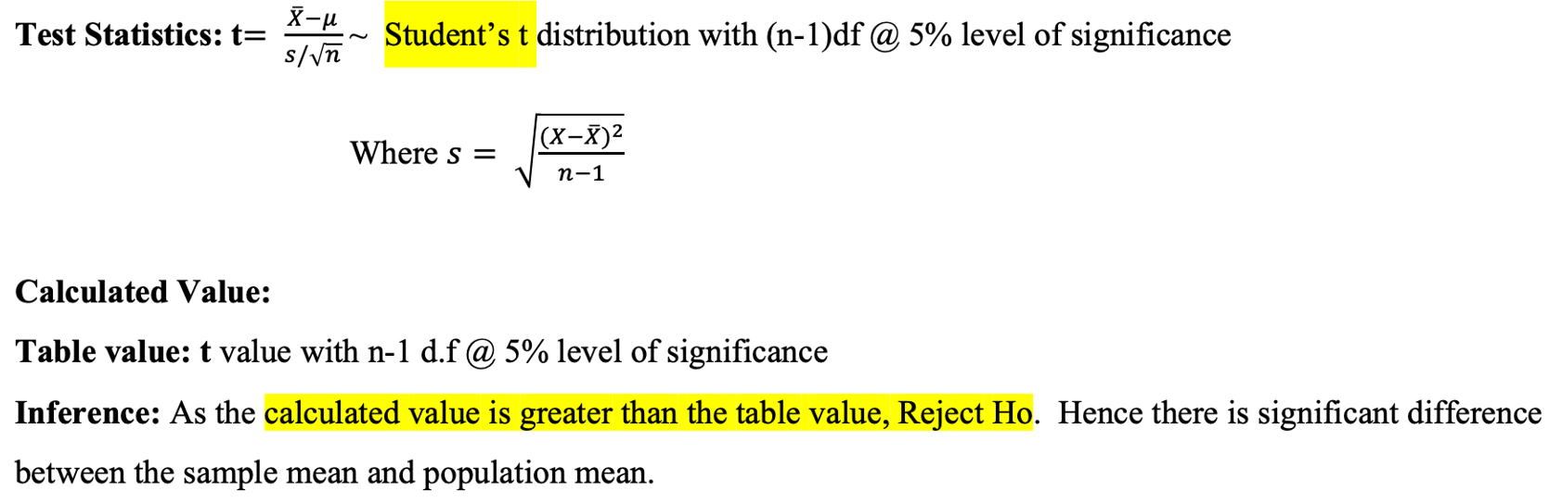
Testing of Mean – One sample
Testing of Mean – One sample – Small Sample(<30) and Population SD is unknown

Slide 16
x | X-X-BAR (X – 50) | X-XBAR)2
80 | =80-50 = 30 | 900 | 1000/3
30 | 0 | 0 | 333
60 | 10 | 100 | SQRT(333) = s
30 | 0 | 0

Slide 17
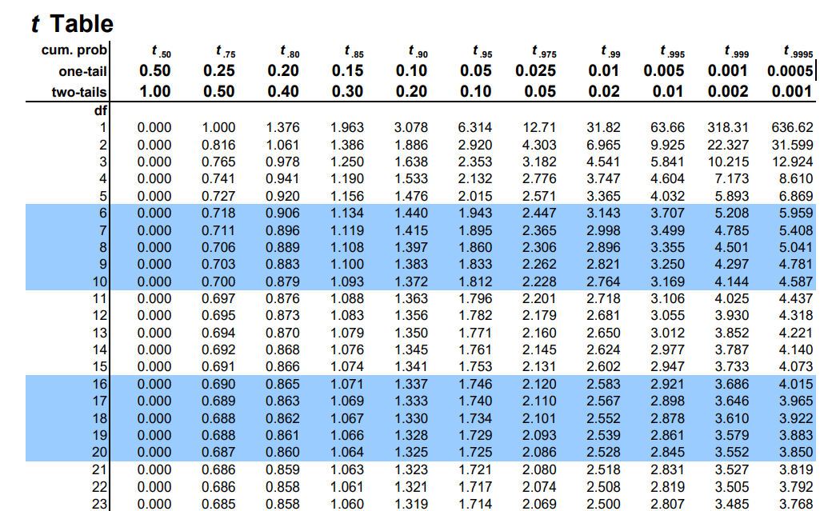
T-table

Slide 18
Degrees of freedom Example
Degrees of Freedom (DoF) represent the number of independent values that can vary in a statistical calculation.
Suppose you have the following 5 exam scores ( 0 to 100):
x1, x2, x3, x4, and x5 100, 100, 100, 100
You are given that the mean of the scores is 80.
Now suppose the first four scores are allowed to vary freely.
BUT — once 4 of the scores are finalized, the fifth value is fixed to maintain the same mean (80).
Thus, Degrees of Freedom = n - 1 = 5 - 1 = 4

Slide 19
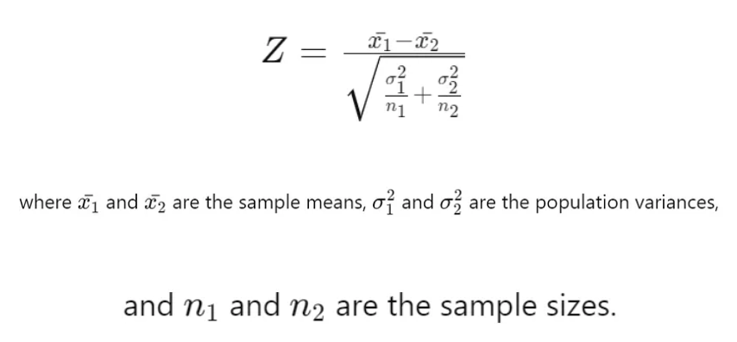
Testing of Mean – Two Independent sample
Testing of Mean – Two independent sample – Large Sample(>=30) and Population SD is known
Test-statistic:

Slide 20
Two Independent Sample Z-Test
Problem Statement:
A researcher wants to compare the average daily calorie intake of male and female adults in a city. Two independent random samples are taken:
Sample 1 (Males): n1=40, mean X1_bar =2500, population standard deviation σ1=300
Sample 2 (Females): n2=35, mean X2_bar=2300, population standard deviation σ2=250
At 5% level of significance, test whether there is a significant difference in the mean calorie intake between males and females.

Slide 21
Step 1: define the hypothesis
We conduct a two-sample Z-test because:
  Sample sizes are large (n1,n2≥30)
  Population standard deviations (σ1, σ2​) are known
Null Hypothesis (H0​): There is no significant difference between the mean calorie intake of males and females. H0:μ1=μ2
Alternative Hypothesis (H1H_1H1​): There is a significant difference between the mean calorie intake of males and females. H1:μ1≠μ2
This is a two-tailed test.

Slide 22
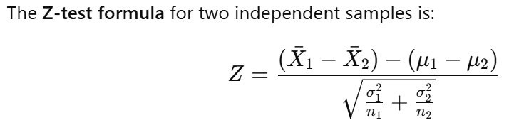
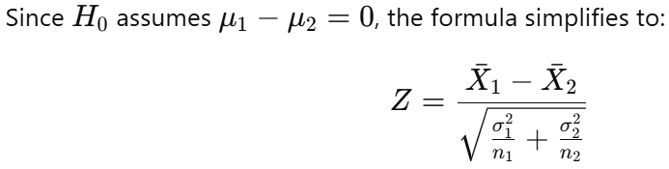
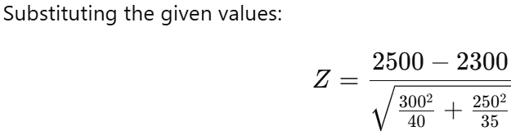
Step 2: Compute the Test Statistic
Z comes out to be ?

Slide 23
Step 3: Find the Critical Z-Value
For a two-tailed test at 5% significance level (α=0.05), we look up the Z-table:
Zcritical =±1.96
Step 4: Compare and Make Decision
Calculated Z-value = 3.15
Critical Z-value = ±1.96
Since Z-calculated > Z critical, we reject the null hypothesis H0​.

Slide 24
Step 5: Final Inference
There is a statistically significant difference in the mean calorie intake of males and females.
This suggests that gender has an influence on daily calorie consumption.

Slide 25
Session Summary
In this session, we have discussed about:
Understand when to use which statistical tests
Apply and practice the various steps of Hypothesis Testing
Understand the process of one sample and two sample tests.
Draw inferences and conclusion.
Understand the concept of degrees of freedom

Slide 26
Reference Links
Introduction to Hypothesis Testing
Frequently asked hypothesis testing interview questions and answers – part 1
Frequently asked hypothesis testing interview questions and answers – part 2
Frequently asked hypothesis testing interview questions and answers – part 3
Sampling methods guide
How to Collect Data Effectively: Methods, Questionnaire Design, and Data Sources Explained
Probability Distributions in Python
Step-by-Step Guide to Two-Sample Z-Test for Large Samples (Population SD Known)

